Slide 1

#lifeapp
A world better
prepared to help in times of disaster

Slide 2
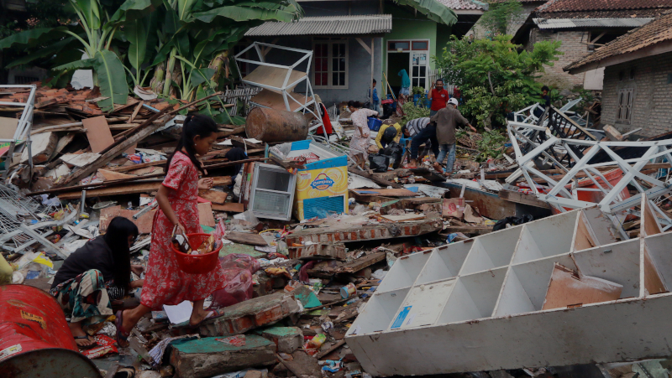
Earthquakes, conflicts, floods & droughts devastate lives
Making the process of mobilising resources for disaster relief efforts seamless, faster and more effective through innovative fintech solutions

Slide 3
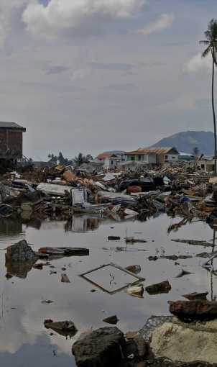
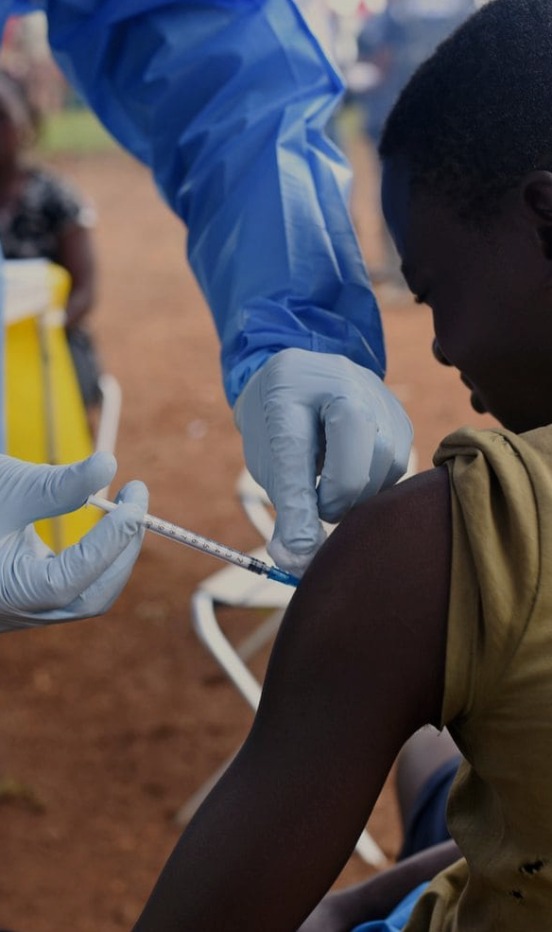
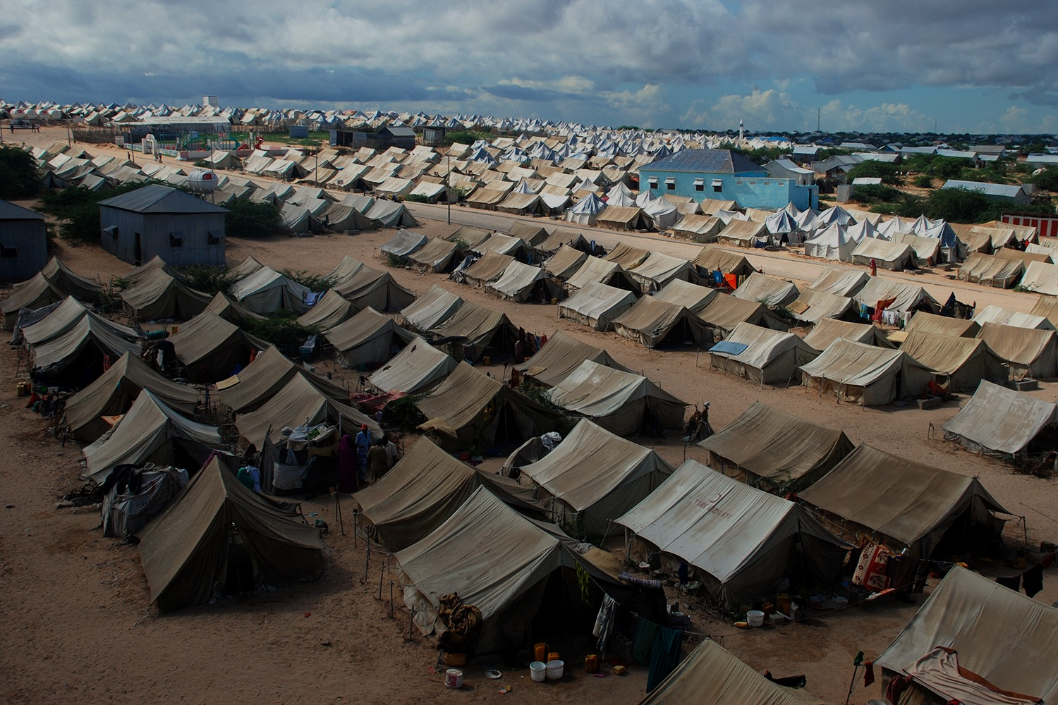
>200m
$27.3bn
3 days
> 200m people require humanitarian assistance survive
$6.5bn was donated privately & $20.7bn from Governments in 2017
A large % of this funding is lost
Minimum 3 days to process donations
During disaster relief, 3 days is a long time

Slide 4
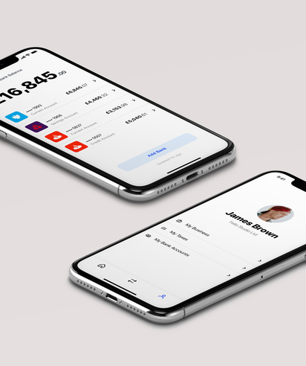
LifeAPP
A WhatsApp based fin-tech product
Enables seamless transfer of donor funds to where the relief is required
For urgent response for people suffering from humanitarian crises e.g. earthquakes, tsunamis, etc.

Slide 5
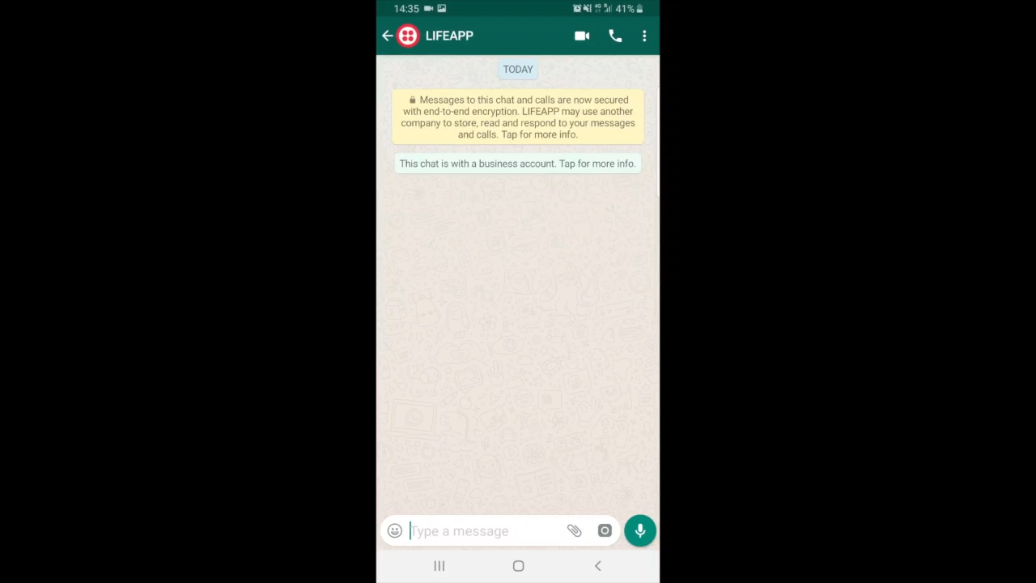

Slide 6




LifeAPP allows for a more seamless donation processes
3 days to 3 seconds
Donor verification and AML via biometrics
Solving the last mile problem
Improved efficiencies of fund collection and data analytics

Slide 7

Our tech

Slide 8

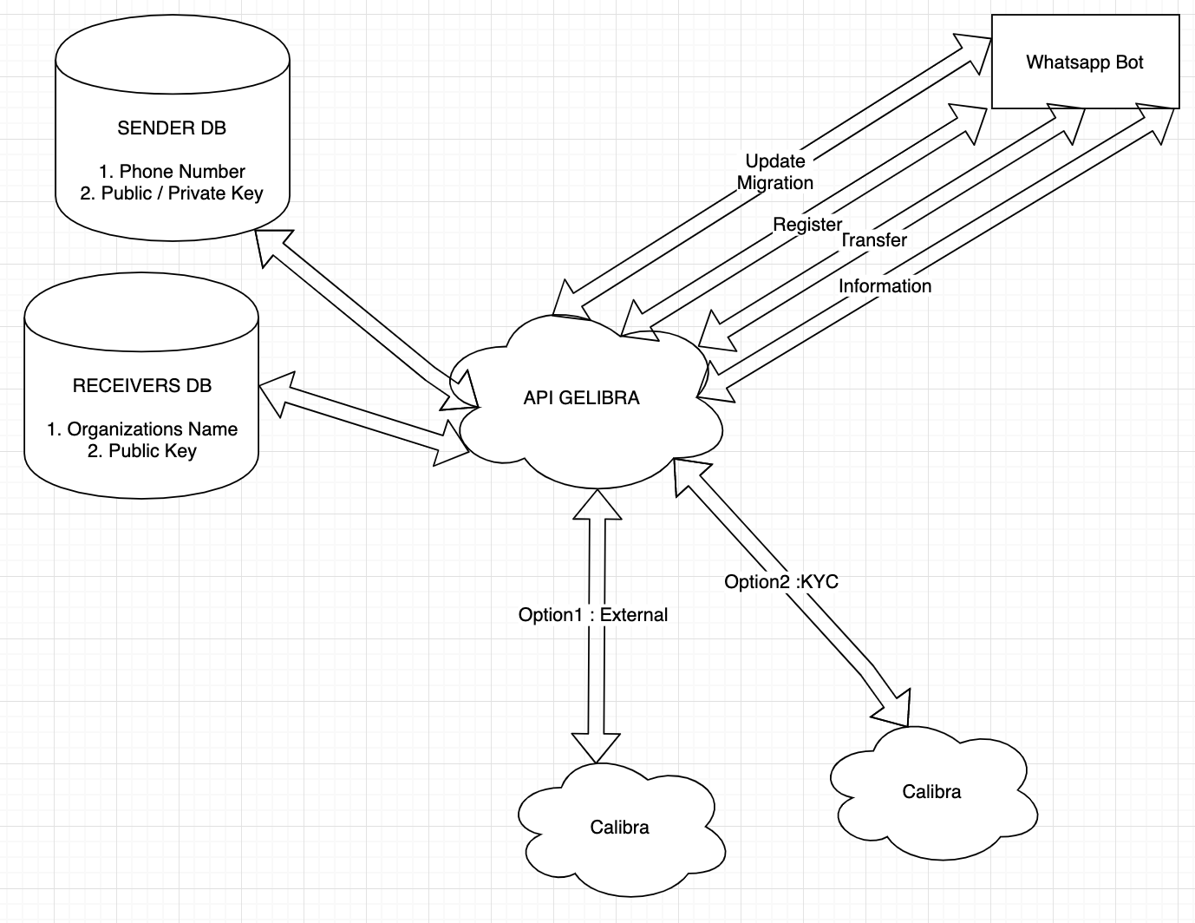
Technology

Slide 9
Security
Securing financial data & transactions using biometric details i.e. finger prints or facial recognition
Audit trail
Know Your Customer (KYC)
Application up and running and ready to use!

Slide 10

Stakeholders
B2C
B2B
Partnerships
Individuals donating funds
to humanitarian relief
Plug and Play fund raising for humanitarian and donor organisations
Enabling services such as analytics & marketplace for disaster relief services

Slide 11
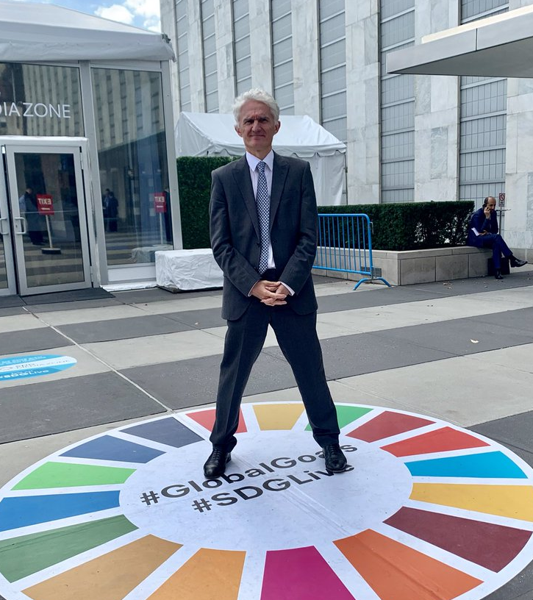





“Humanitarian responses do more than provide immediate life saving needs. They also help further the UN Goals addressing hunger, clean water, sanitation, education, healthcare, gender equality and resilience”
Sir Mark Andrew Lowcock
— United Nations Under-Secretary-General for Humanitarian Affairs and Emergency Relief

Slide 12




Proposed Timeline
Oct‘19
Dec‘19
Jan‘20
July‘20
Refining features with stakeholders and customer testing
Pilot with partner organisations
Prototype
Development
Global roll out

